Slide 1
CITY TOUR GUIDE
BY
Apurv Verma
Ashish Prasad
Priyanshu Raj

Slide 2
AIM
City Guide is a project to create a free, complete, up-to-date and reliable worldwide travel guide.
In our database we aim to provide virtual tours of major destination cities from around the globe.
Along with the images and comments left by other tourists, the system would be able to suggest a suitable travel spot to a customer based on his taste and preferences.

Slide 3
RATIONALE
Tourism forms an integral part of any economy. It promotes development of an area.
The potential problems that a tourist may face include:
Lack of information about the destination places according to his/her interest.
Lack of information about how to reach that destination, its landmarks, places to visit, hotels, restaurants, places of historic relevance, arts and museums, etc.
Reviews of other tourists for further assistance.

Slide 4
IMPLEMENTATION
The City Guide Project will group Cities and their Tourist_Attractive_Spots and their Events_of_Interest as per different categories.
Events_of_interest includes various types of fairs/ festivals, carnivals, exhibitions, etc...
Various categories include hill stations, pilgrimage, sea beaches, historical monuments, amusements, etc...

Slide 5
SCHEMA DIAGRAM
CITY
GUIDE
TOURIST
C_ID | Name | State | Zone | Country | Weather | Best_Visit_Time | How_to _Reach | Railway_Station | Airport | Description
Int | Char | Char | Char | Char | Text | Text | Text | Text | Text | Text
G_ID | Name | C_ID | Zone | Gender | Ph.no | Address
Int | Char | Int | Char | Char | Int | Text
T_ID | Name | Gender | Email | Ph.no | Address
Int | Char | Char | Char | Int | Text

Slide 6
SCHEMA (Continued...)
TOURIST_SPOTS
EVENTS_OF_INTEREST
CATEGORY
ES_ID | Name | C_ID | Image | CAT_ID | Best_Time_of_Visit | Description
Int | Char | Int | Image | Int | Text | Text
EOI_ID | Name | Image | Date | C_ID | CAT_ID | Description
Int | Char | Image | Date | Int | Int | Text
CAT_ID | Name
Int | Char

Slide 7
Schema (Continued...)
HOTELS/RESORTS
RESTAURANTS
TOURIST_COMMENTS
H_ID | H_ID | Name | C_ID | Star | Resort | Rate | Ph.no | Address
Int | Int | Char | Int | Int(1-5) | Boolean | Int | Int | Text
R_ID | Name | C_ID | Specialty | Cuisine | Ph.no | Address
Int | Char | Int | Text | Text | Int | Text
TC_ID | C_ID | T_ID | Time_of_Visit | Expected_ Expenditure | Ratings | Comments | Suggestions
Int | Int | Int | Char | Int | Int(1-10) | Text | Text

Slide 8
ER Diagram
Image
Ph.no
C_ID
Cat_ ID
Gender
Desc.
Addr
Name
Time of Visit
C_ID
TOURIST_ SPOTS
Best
Time of Visit
T_ID
Expenses
GUIDE
TS_Id
C_ID
Rating
Name
REVIEWS
G_ID
TC_ID
Comment
GUIDE IN CITY
SPOTS IN CITY
CAT. OF SPOTS
TOURIST_ COMMENT
Suggestion
C_ID
Name
Best time of Visit
State
CITY
How to reach
CATEGORY
Cat_ID
Zone
Railway SStation
Country
Name
Airport
Weather
Desc.
EVENT REVIEWS
GIVEN BY
Best time of Visit
EVENTS IN CITY
HOTEL IN CITY
REST. IN CITY
CAT. OF EVENTS
H_ID
Name
C_ID
HOTELS/ RESORTS
RESTAURANTS
EVENTS_OF_INTEREST
TOURIST
Stars
Resort
Rate
T_ID
Addr
R_ID
Addr
C_ID
Ph.no
EOI_ Id
Name
Email
Name
Ph.no
Date
Ph.no
Addr
C_ID
Cuisine
Name
Image
Gender
Specialty

Slide 9
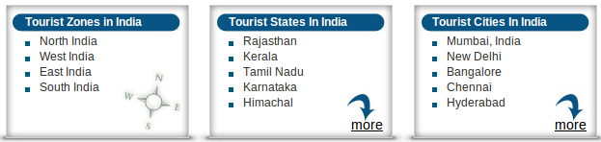
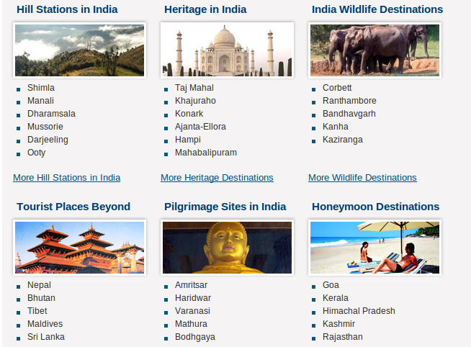
GUI PROSPECT
We plan to provide you with an interface that will group the cities and tourist attractions similar to as given by the image alongside.

Slide 10
GUI PROSPECT (contd..)
Category of tourist destination
Adventure
Art
Cultural
Educational
Fair & Festival
Heritage /Historic Monuments
Hill station
Honeymoon
Health
Sea Beaches
Shopping
Wildlife
Miscellaneous
Menu-based tourist spot selection.

Slide 11
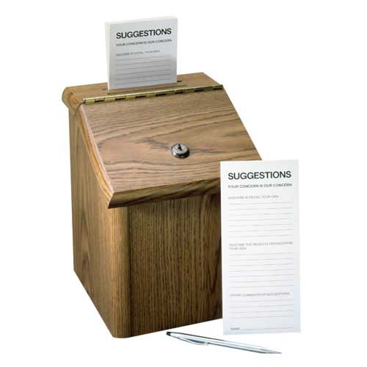
SUGGESTIONS

Slide 12
THANK YOU

